Slide 1

Simulink Model Based Design
Islam Mansour

Slide 2
Objective
The system design consisting of several stages such as
Requirement Specification
Design
Prototyping
Evaluation
The interactive system design is highly iterative

Slide 3
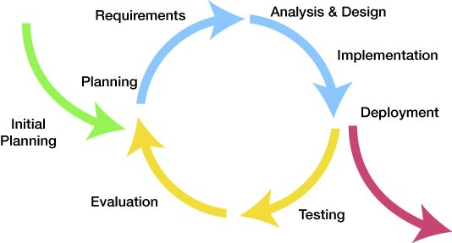
Objective
The iterative life cycle is
Time consuming and
Also requires cost (for coding and testing)
It is always good if we have an alternative method that reduces
Time, effort and cost required for the design life cycle
Model-based design provides one such alternative

Slide 4
Motivation
Simulink provides the tools for model-based design, which we have used for drag model simulation:
Aerospace Blockset
Aerospace Blockset CubeSat Simulation Library
Control System Toolbox
System Test, Validation, and Verification
Basic Atmosphere Model (complex models needs to implement it yourself)
Spherical Harmonic Gravity Model

Slide 5


Slide 6
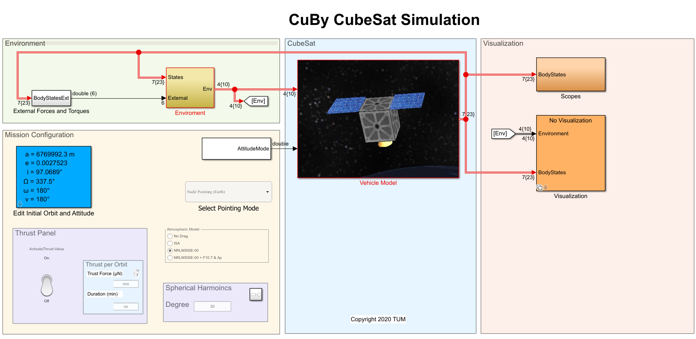
CuBy CubeSat Drag Simulation

Slide 7
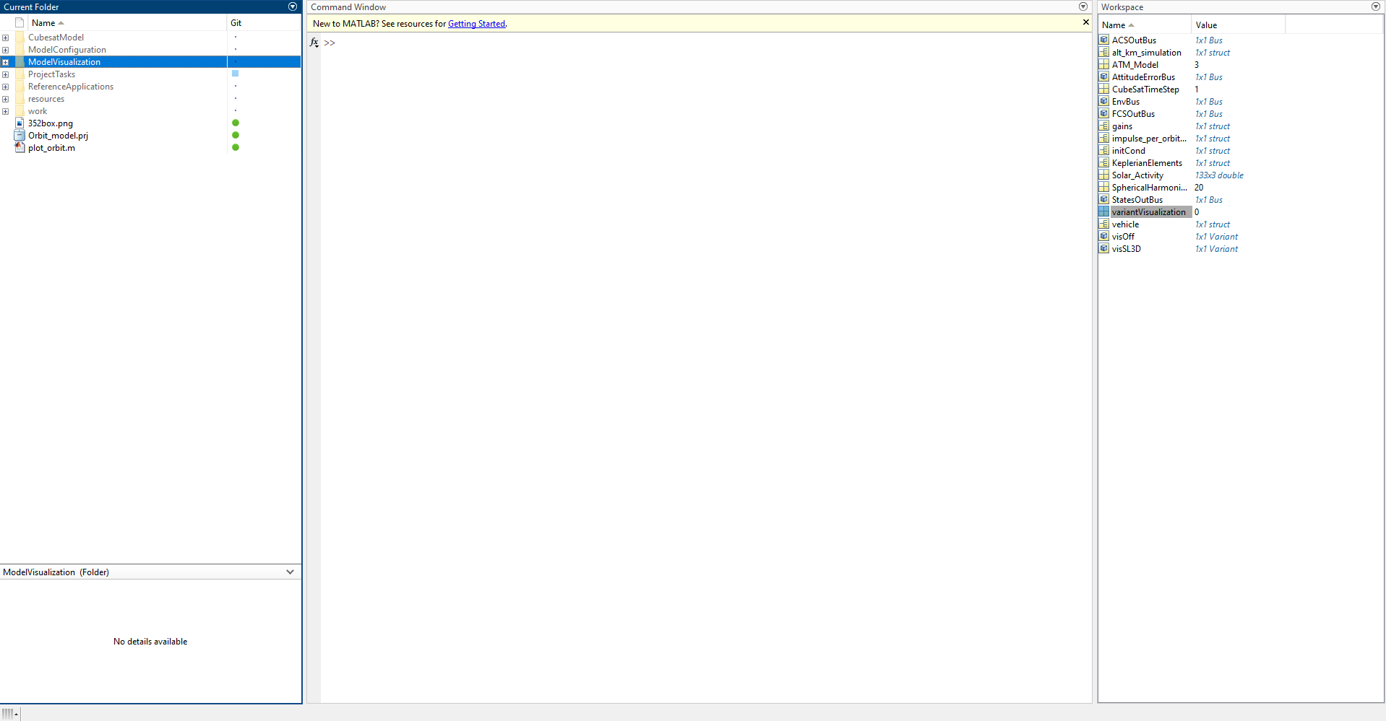

Slide 8
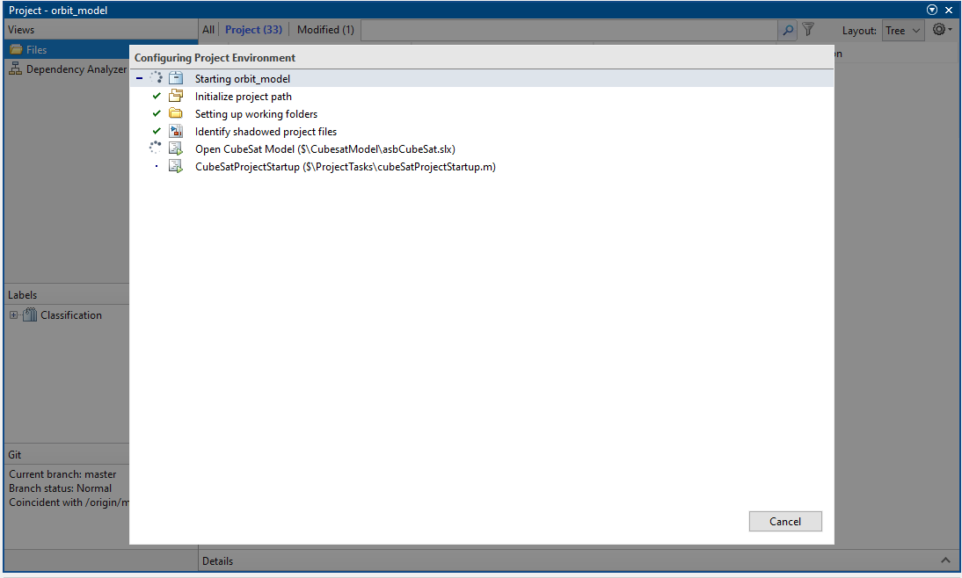
Loading the model

